Slide 1
IPL VISUALIZATION ASSIGNMENT
RAMYA SREE NARWA

Slide 2
The Indian Premier League, or IPL, is a T20 cricket league, which was founded in 2008 and is held every year. It sees participation from both national and international players, and eight teams representing eight Indian cities compete with each other in a double round-robin format in the league stages, which are followed by playoffs. Over the years, IPL has become one of the most-watched and most attended live sporting events all over the world.
IPL statistics over the years since its inception in order to create an infographic for a newsletter.

Slide 3
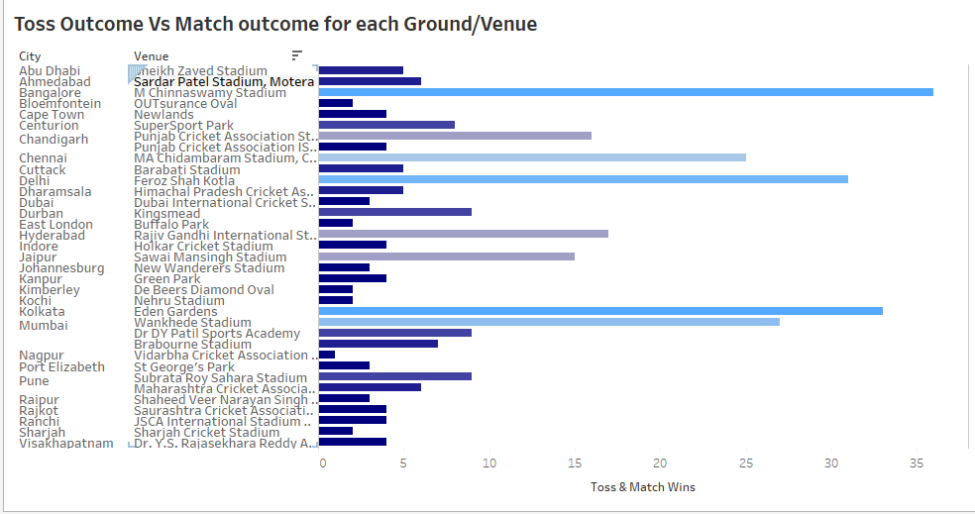
Toss vs match outcome
Bangalore, M Chinnaswamy stadium has highest occurrences of similar toss and match outcome.

Slide 4
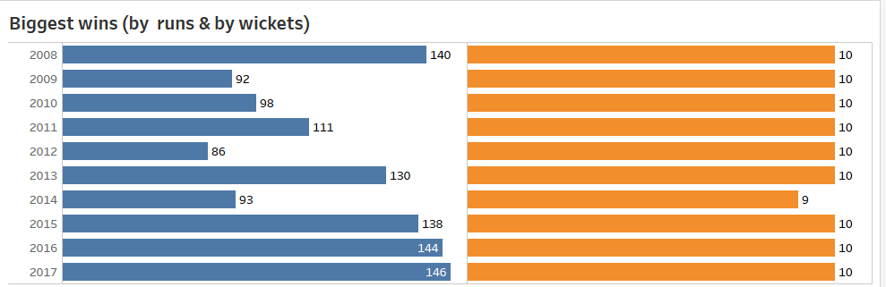
Biggest wins by runs and wickets
Biggest wins by runs happened in the year 2017 where a team won with a difference of 146 runs.
Most of the years, biggest wins happened with 10 wickets.

Slide 5
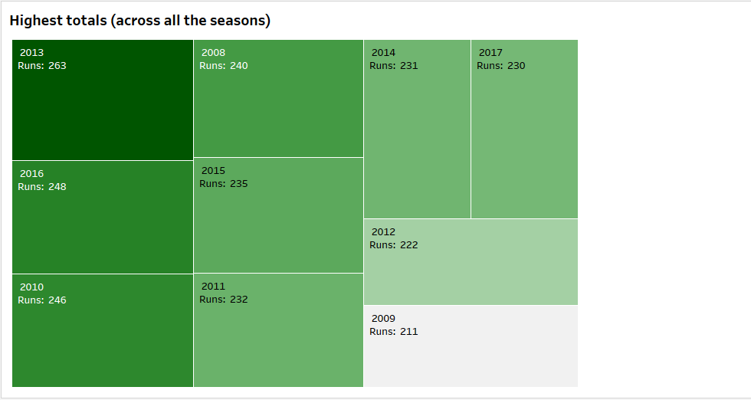
Highest totals across all seasons
Highest runs, 263 were taken in the year 2013 for a match.

Slide 6
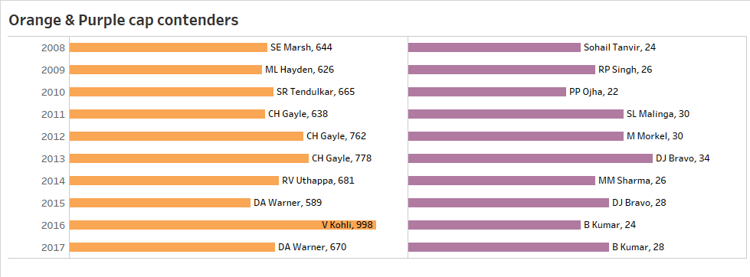
Orange and purple cap contenders
Virat kohli is on top for Orange cap contenders with 998 runs
Bravo with 34 runs stands as top Purple cap contender in bowlers.

Slide 7
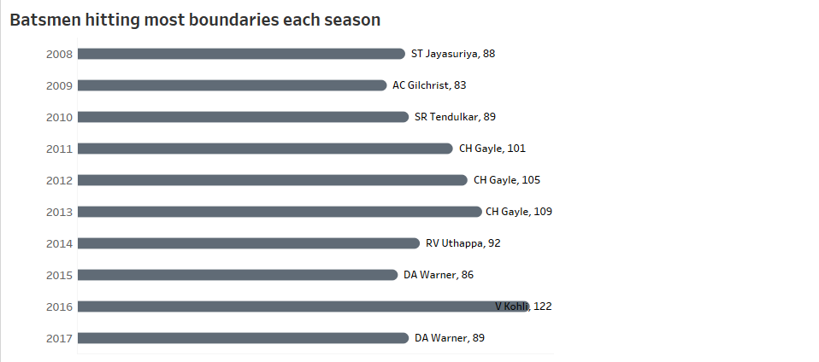
Most boundaries each season by batsman
Highest boundaries were hit by Virat Kohli, 122 boundaries were hit in the year 2016.

Slide 8
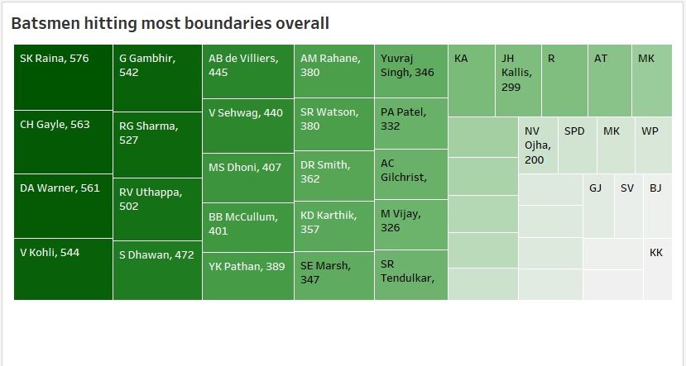
Most boundaries overall
Raina has hit 576 boundaries and is on top when the boundaries of all season are combined

Slide 9
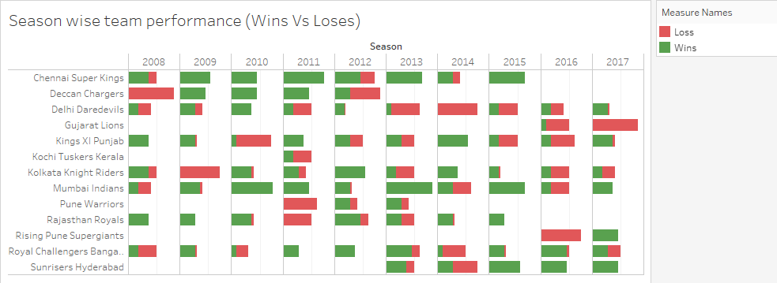
Wins vs loss
Deccan chargers in 2008, KKR in 2009, Pune warriors and Rajasthan royals in 2009, Delhi in 2013, Gujarat in 2017 has not won at least a single match.

Slide 10
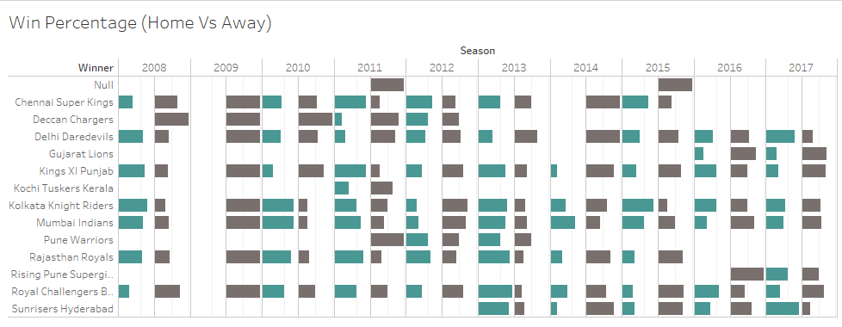
Home vs away wins
Percentage of away wins is high in the year 2009 for all the teams
Percentage if home wins is high in 2013

Slide 11
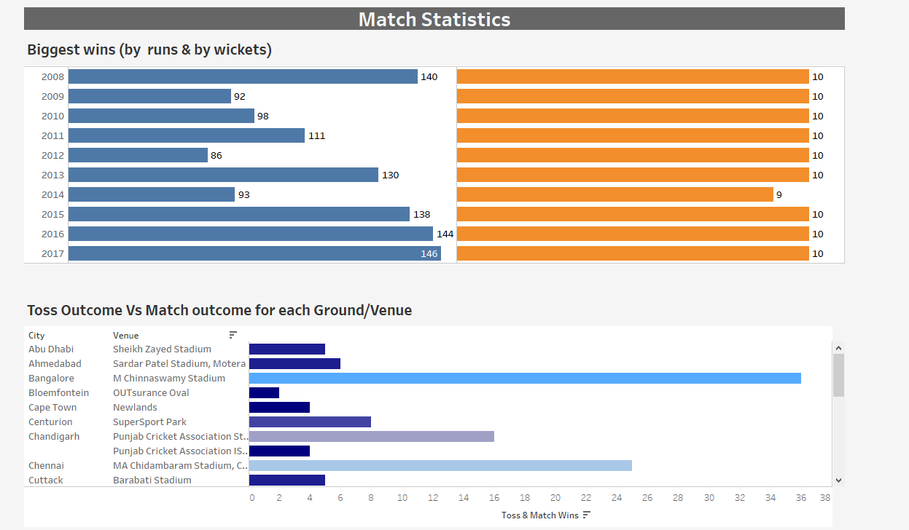
Match statistics

Slide 12
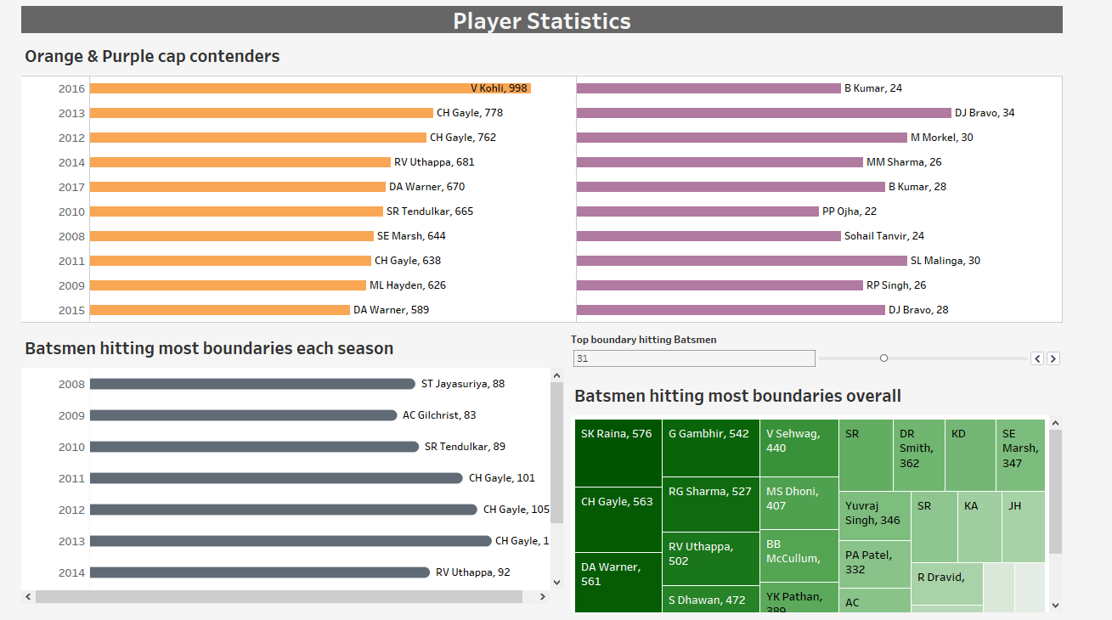
Player statistics

Slide 13
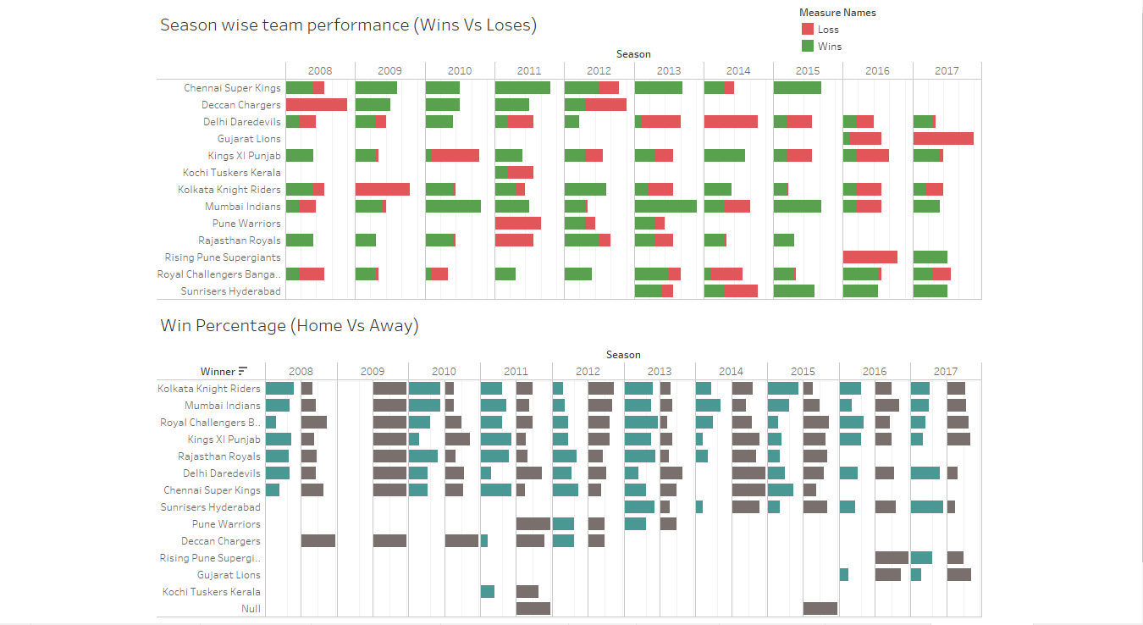
Team statistics

